Slide 1
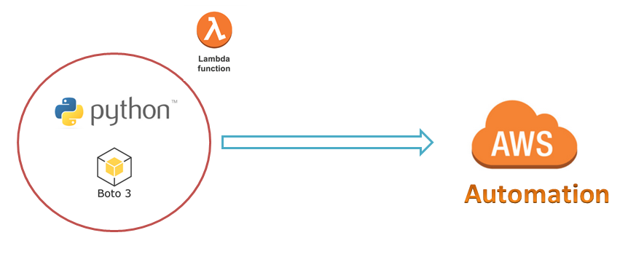
AWS Automation
with
boto3 of Python and Lambda Functions
Boto3 Script to get AWS AccountId
Loop control statements or commands
(break and continue)
Learn how to automate AWS common tasks using boto3 and Lambda

Slide 2
Thank you

